Slide 1

Final Year Project Presentation on
CORVID Intelligent Email Processor
CORVID Team Members
Lekhnath Bhusal (060/BCT/515)
Madhav Sigdel (060/BCT/515)
Mahesh Raj Regmee (060/BCT/515)
Prajwal Shrestha (060/BCT/515)

Slide 2
Our Context
A person receives 100 to 200 messages a day
A Recipient has almost no control over number of incoming mails

Slide 3
Email Mining to the Rescue
Incorporates machine learning and data mining
Mail
  Classification
  Summarization
  Automatic answering
  Spam Filtering

Slide 4
Existing Works
POPFile
  Sfdsdf sdfsdf ss sdf sd
Spammato
  Sdfsdfsdfsdfsdfsdf

Slide 5
Expected Output
An Engine that will give spam status, classify, and present summary of a given mail based on knowledge Base
Engine will be merged with existing email Client
GUI interface to trigger learning approach in the system (personalization)

Slide 6
Our approach
Development of Email Processing Modules
  Filtration
  Classification
  Summarization
Integration of above modules with Thunderbird email client as Extension

Slide 7
Personalization
To make the system learn your //behavior

Slide 8
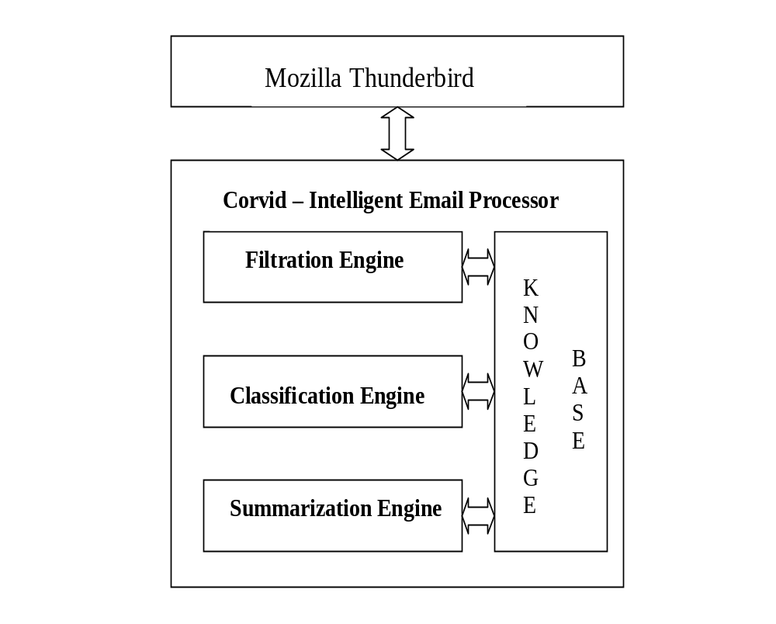
System Architecture

Slide 9
Email Filtration

Slide 10
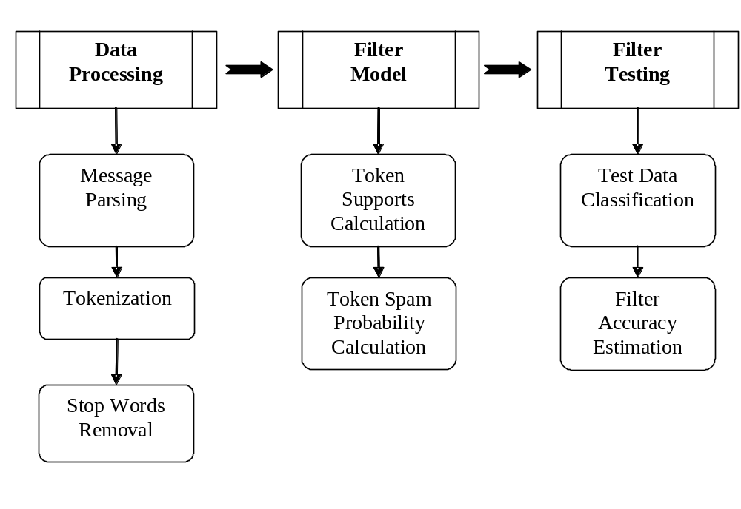
Filter Model

Slide 11
Filtration Tasks : Support Calculation
  Spam email:
  Subject: Congratulations!!!
  Body : you have won a lottery of $25000. Please claim the lottery you have won.
  Ham email:
  Subject: congratulation
  Body: you have been selected for mundus scholarship program.
Item | support
Won | 2
Lottery | 1
Sub: Congratulations!!! | 1
Item | support
Selected | 1
scholarship | 1
Sub: congratulation | 1

Slide 12
Filtration Tasks
Item | probability
Won | 0.9
Lottery | 0.9
Sub.Congratulations!!! | 0.98
  Email:
  Subject: Congratulations!!!
  Body : you have won a lottery.
  Spam probability: 0.99

Slide 13
Email Classification

Slide 14
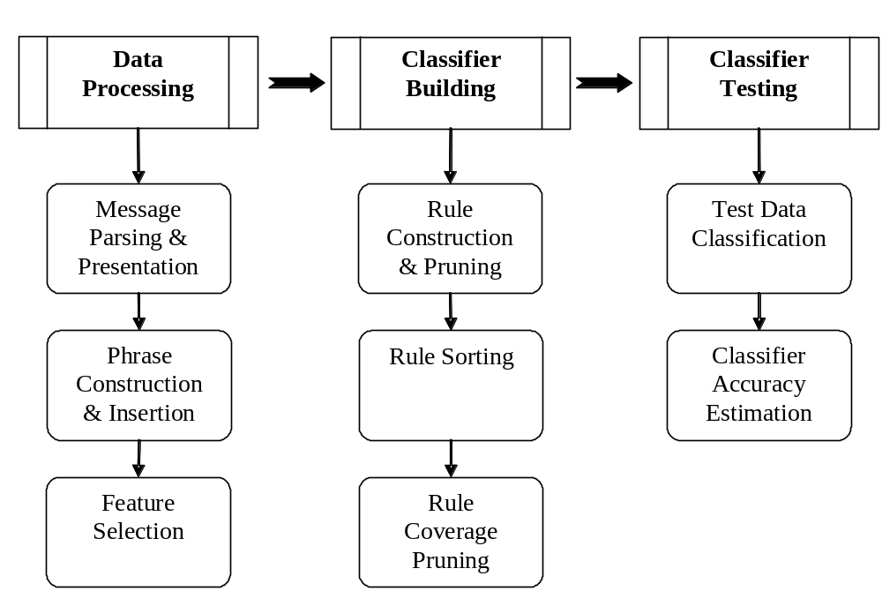
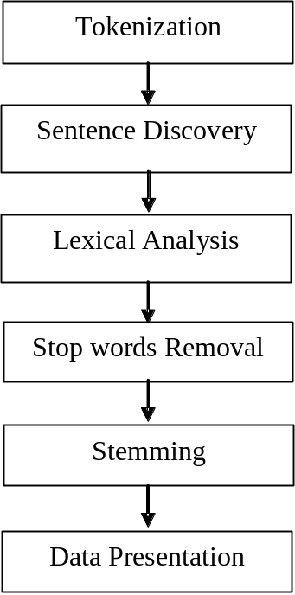
Classification Model

Slide 15
Classification Tasks - Preprocessing
Human Beings are superior to monkeys. Americans think they are superior to Asians.
Tokenization
  Human, Beings, are, superior, to, monkeys,. ,Americans, think, they, are, superior, to, Asians
Sentence Discovery
  Human, Beings, are, superior, to, monkeys,
  Americans, think, they, are, superior, to, Asians

Slide 16
Classification Tasks - Preprocessing
Human Beings are superior to monkeys. Americans think they are superior to Asians.
  Stop words removal
  Human, Beings, superior, monkeys,
  Americans, think, superior, Asians
  Stemming
  Human, Being, superior, monkey,
  America, think, superior, Asia

Slide 17
Classification Tasks - Preprocessing
Human Beings are superior to monkeys. Americans think they are superior to Asians.
Lexical Analysis
hello!->hello,
he!llo->deleted.
Data presentation
Human- 1, Being -2 , superior -3 , monkey -4,
  America -5, think -6, superior -3, Asia -7
1 2 3 4
5 6 3 7

Slide 18
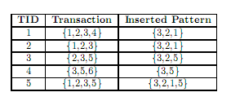
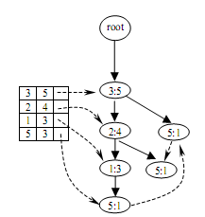

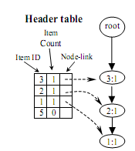

Classification Tasks – Pattern Construction
Final Tree

Slide 19
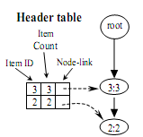
Classification Tasks – Pattern Construction
Lowest frequency item->5
Conditional pattern base of 5:
3 2 1:1
  3:1
3 2:1
Conditional Tree of 5

Slide 20
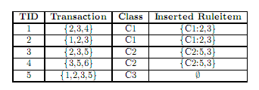
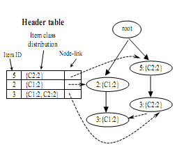
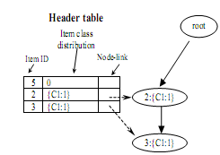

Classification Tasks – Rule Construction

Slide 21
Classifying Email
Construct patterns
Find the rules covering the patterns
Select user specified number of strongest rules
Calculate probability distribution

Slide 22
User Feedback
Classify explicitly
Create the transactions
Add the transactions to transaction database

Slide 23
Email Summarization

Slide 24
Combining Linguistic and Machine Learning
Noun phrases carry the important information
Linguistic technique for noun phrase extraction
Machine learning technique to determine important noun phrases.

Slide 25
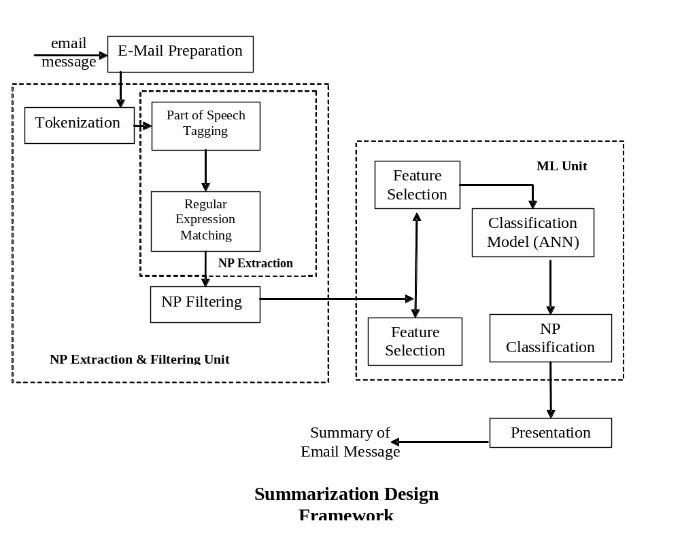
Summarization Model

Slide 26
Summarization Tasks
Preprocessing
  Html Parsing
  Non-literal character removal
  Tokenization
  Processed Email
POS tagging
  Dictionary Search
  Transformational Rules
Noun phrase extraction
  Data Representation
  Regular Expression Matching
    (Adjective | Noun) * (Noun Preposition)? (Adjective | Noun)* Noun

Slide 27
Contd..
Candidate Noun phrase construction
  Noun Phrase Filtering
Noun Phrase Ranking
  Statistical Feature association such as TFIDF, first occurrence, position etc.
  Find importance using ANN
Extracting important sentences containing salient noun phrases

Slide 28
Summarization Steps
Hello guys,
-- > We’ve the final project presentation and demo of our project on 14th February.
-- > Lets integrate all the modules.
Sample Mail
Original Mail
hello guys we’ve the final project presentation and demo of our project on 14th February lets integrate all the modules
Tokenization
hello
Hello
hello guys
we’ve the final project presentation and
demo of our project on 14th February .
lets integrate all the modules .
Preprocessed Mail

Slide 29
Contd..
hello guys we’ve the final project presentation and demo of our project on 14th February .
Lets integrate all the modules .
POS Tagging and
Noun Phrase Extraction
Noun Phrases
    (Adjective | Noun) * (Noun Preposition)? (Adjective | Noun)* Noun
hello guys we’ve – 0.8765
final project presentation – 0.92
all the modules – 0.8
Noun Phrase Ranking
we’ve the final project presentation and
demo of our project on 14th February
Sentence Extraction

Slide 30
Integration into Mozilla Thunderbird

Slide 31
Major Integration Tasks
Creating XPCOM Component
  IDL, Typelib and Header using XPIDL
  DLL using Microsoft Visual Express and Gecko SDK
Register the XPCOM Component
Script and Overlay
  Interaction
  Event handling
  User Interface

Slide 32
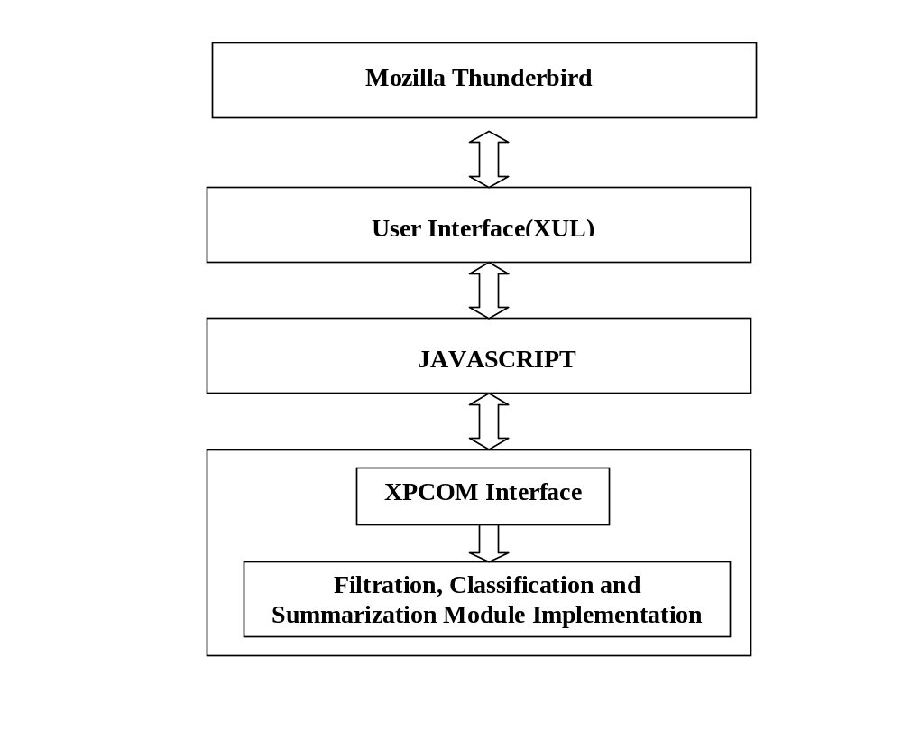
Integration Model

Slide 33
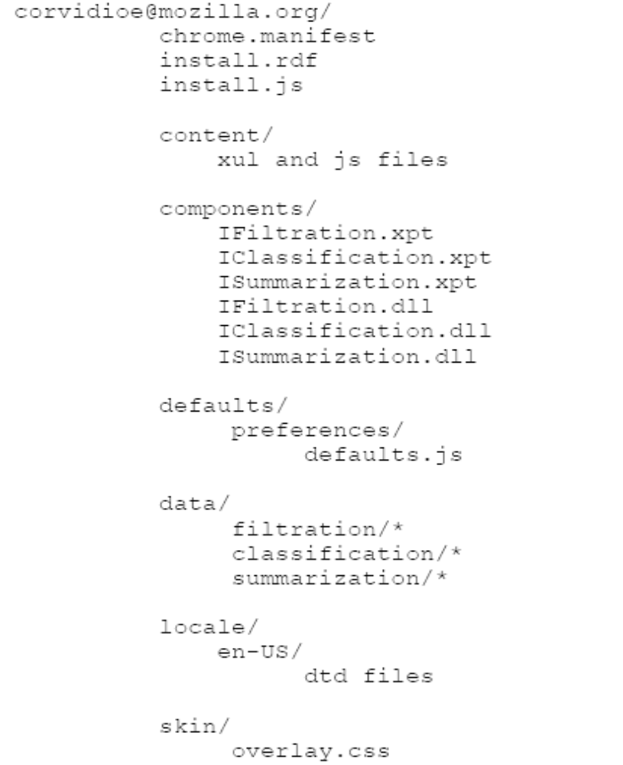
Extension Folder Structure

Slide 34
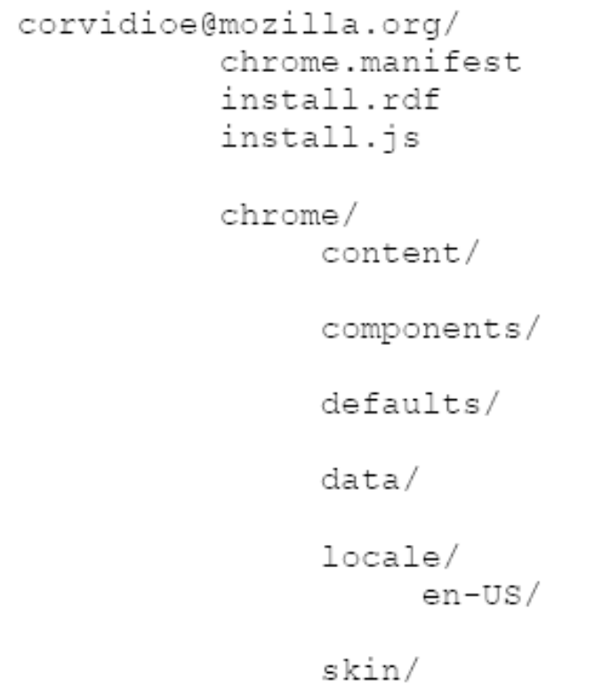
Extension Packaging

Slide 35
Experimental Results

Slide 36
Experimental Results
Email Filtration
  Bayesian Approach
    Strong Independence Assumption
  Generic Email Corpus for training

Slide 37
Experimental Results
Email Classification

Slide 38
Experimental Results
Email Summarization
  Error Accumulation
    POS Tagging
    NP Extraction
    NP Ranking
  Rule based Analysis
    Date / Time Expression
    Address book references

Slide 39
Further Works

Slide 40
Further Works
Layered Processing
  Rule Based Analysis followed by Statistical Analysis

Slide 41
Summary
Email Mining different from text mining
Bayesian approach

Slide 42
References
John Graham-Cumming, Three years of Spam Mutation. In the Proceedings of The Spammer’s Compendium, January 2003
Paul Graham, Better Bayesian Filtering, 2003
Mehran Sahami, Susan Dumais, David Heckerman and Eric Horvitz, A Bayesian Approach to Filtering Junk Mail. In the Computer Science Department Stanford University.
Julia Itskevitch, Belorussian, Automatic Email Classification using Association Rules. State Polytechnic Academy, 1997
Smaranda Muresan, Evelyne Tzoukermann, Judith L. Klavans, Combining Linguistic and Machine Learning Techniques for Email Summarization
http://docs.mandragor.org/files/Misc/Mozilla_applications_en/
Other Related References

Slide 43
Thank you

